Slide 1


Slide 2

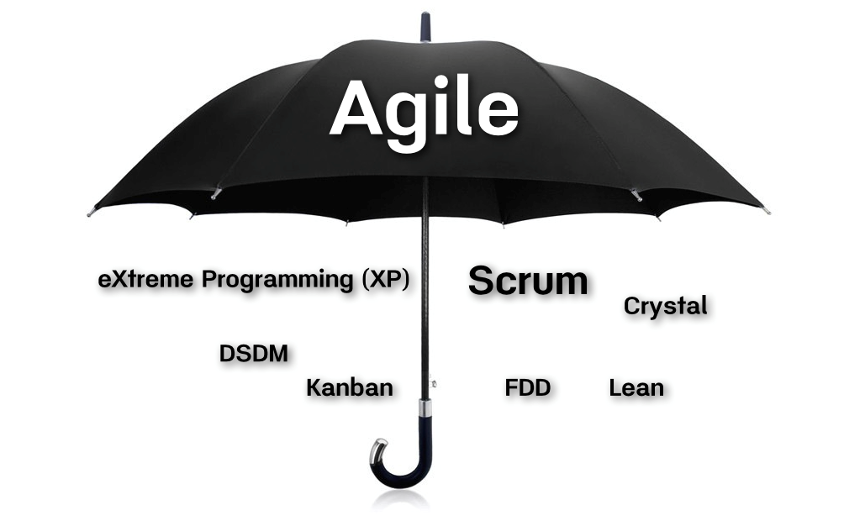
Scrum IS Agile; Agile IS NOT Scrum
Heather Tooill @HeatherTooill

Slide 3

Are you
Notes:
How many of you think you are Agile?
How many of you are practicing Scrum?
How many of you are practicing “Wagile” or “ScrumBut”?
How many of you think you are NOT Agile?

Slide 4

A Little About Me
Manager of Solutions Delivery, BA & Scrum Master with Leading EDJE in Columbus, Ohio
Currently working as a Scrum Master
Java Developer for 9 years in multiple industries
Passionate about Agile
Got my PMI-ACP in December of 2014
Got my PSM 1 in March 2016
Experience as a Scrum Master, BA, and Agile Coach

Slide 5
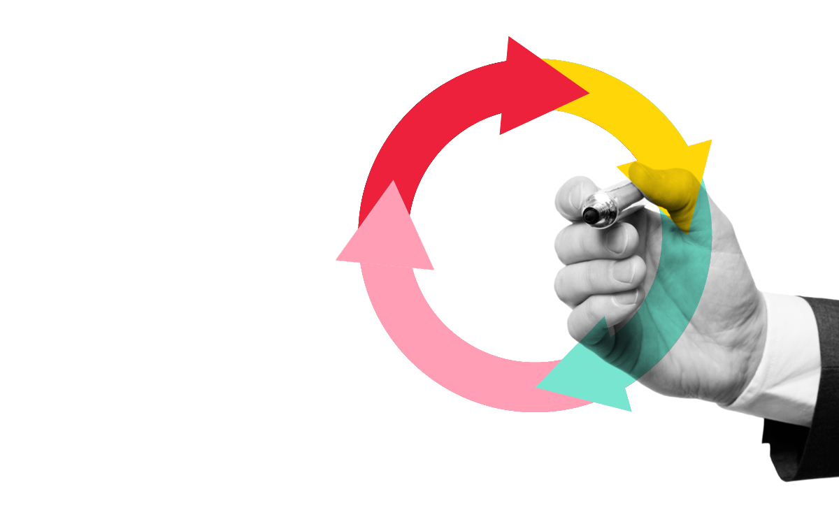
Itinerary
What is Agile? (High level)
Agile Manifesto
Waterfall Process
Scrum Basics
ScrumBut (Wagile)
Other Methodologies
Are You Agile?
Questions

Slide 6

Notes:
Presentation is meant to have you ask questions about your organization.
Think about questions you came here hoping to get answered.
There will be time at the end to answer questions I don’t hit in the presentation

Slide 7
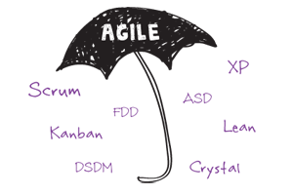


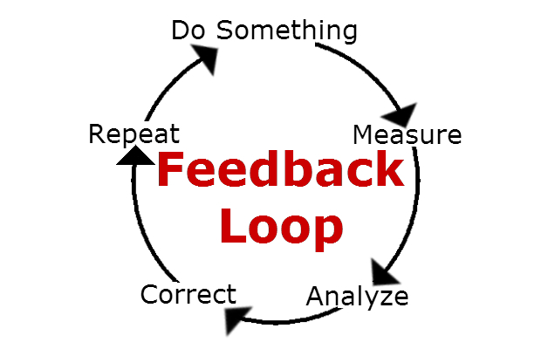
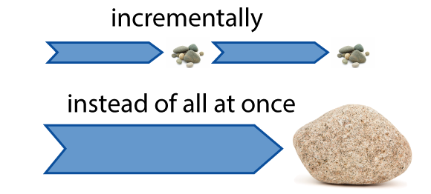
What is Agile?
Notes:
Single Methodology with multiple defined practices
Set of principles we follow every day
Manifesto/Mission Statement that we believe in and follow
Incremental process – smaller parts
Feedback loops

Slide 8
Agile Manifesto
Individuals and interactions over processes and tools
Working software over comprehensive documentation
Customer collaboration over contract negotiation
Responding to change over following a plan
That is, while there is value in the items on
the right, we value the items on the left more.

Slide 9
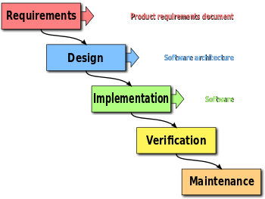
Waterfall Process
Notes:
How many of you are new developers that have never worked in an Waterfall Environment?
If very few, don’t spend as much time on this slide
If there are some, that is why this slide is here…
Requirements at the beginning of process, but no feedback loop to adapt to change
Design for ENTIRE project done before Implementation
Implementation without demo to User
Verification only after implementation is Complete

Slide 10
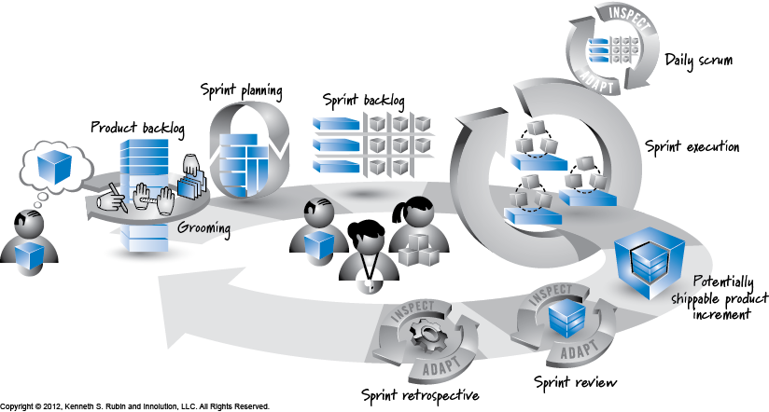
Scrum Basics
Notes:
Create and prune a Product Backlog
Hold Sprint Planning Meetings every iteration
Create a Sprint Backlog from the Sprint Planning Meeting
Hold Daily Scrums – What did yesterday; What doing today; Any Impediments
Implement stories during Sprint Iteration (2 – 4 weeks)
Create Potentially Shippable product at end of Sprint
Sprint Review with all Stake holders (Feedback loop!)
Sprint Retrospective with Sprint Team – What did we do good? What could be improved?
Start over again!

Slide 11
Scrum BUT…
(ScrumBut)(Reason)(Workaround)
You are NOT Scrum!!
Notes:
"(We use Scrum, but) (having a Daily Scrum every day is too much overhead,) (so we only have one per week.)"
"(We use Scrum, but) (Retrospectives are a waste of time,) (so we don't do them.)"
"(We use Scrum, but) (we can't build a piece of functionality in a month,) (so our Sprints are 6 weeks long.)"
"(We use Scrum, but) (sometimes our managers give us special tasks,) (so we don't always have time to meet our definition of done.)“
If your team is making any of these statements, you should look into your organization and realize you are NOT scrum!

Slide 12
You may NOT be Scrum BUT… Are you still agile?
Notes:
Think about the reasons your are “Scrum But”;
Think about the processes you are using instead of the Scrum methods;
Are you pulling items from other Agile Methodologies?
Are you still following the Agile Manifesto?

Slide 13
Little ‘a’ Agile
vs.
Big “A” Agile
Notes:
Little a – a mind set. Literally living the manifesto. Getting products to the user faster and taking feedback
Big A – processes, what some “think” it should be. Prescribing process vs doing what is needed/right.
Wait…isn’t one of the lines in the manifesto “Individuals & Interactions OVER Processes and Tools“?

Slide 14



Notes:
Individuals & Interactions OVER Processes and Tools
Working Product OVER Comprehensive Documentation
Customer Collaboration OVER Contract Negotiation
Responding to Change OVER following a plan

Slide 15




A Few Other Methodologies
Notes:
Lean – Value Stream Mapping; Minimum Viable Product (MVP); Eliminating Waste
Kanban – Continual priority change; Kanban Board (Visualized Workflow); No Iterations; No prescribed roles
FDD – Feature Driven Development; Iteration is a Feature; Quick Feedback
XP – Pair Programming; Test Driven Development; Iterative; Continuous Integration

Slide 16

These are ALL Tools!!!
Notes:
Do what works best for your team!
Pull from all the different methodologies!
Try being ScrumBan – Entirely Scrum but using a Kanban Board!
Try having a Scrum Master and Iterations, but using Pair Programming and Test Driven Development
Don’t like having Daily Standups or strict iterations? Try Kanban or FDD
Think outside of the box!

Slide 17
We are ALWAYS learning!
Learn
From other practitioners
What NOT to do
What you can do
What works for other organizations
What may work for your organization
Be a SPONGE!!
Not everything you know, will be used in all situations

Slide 18



Notes:
Individuals & Interactions OVER Processes and Tools
Working Product OVER Comprehensive Documentation
Customer Collaboration OVER Contract Negotiation
Responding to Change OVER following a plan

Slide 19
Think about it! Are you
Notes:
Don’t get a defeated attitude or feel like you are not Agile just because you are not Scrum.
Be positive. Hang the Manifesto in your office. Come up with a system that works for your team/company
Be introspective and if you hear a “Well…we aren’t really Agile” or “We are more Wagile”; Make a meeting with that team member and listen to their doubts. If they are valid, come up with a plan to get back into Agile. If they are already handled, remind your team that Agile != Scrum!

Slide 20

What is
Agile Story?
(Do you have Questions?)

Slide 21
Thank You!
Heather Tooill
Leading EDJE
Heather.Tooill@leadingedje.com
@HeatherTooill
http://speakerrate.com/speakers/133371-htooill

Slide 22
How much “Mix & Match” can I do before I have diluted the process too much? Can I have too much “Mix & Match”?

Slide 23
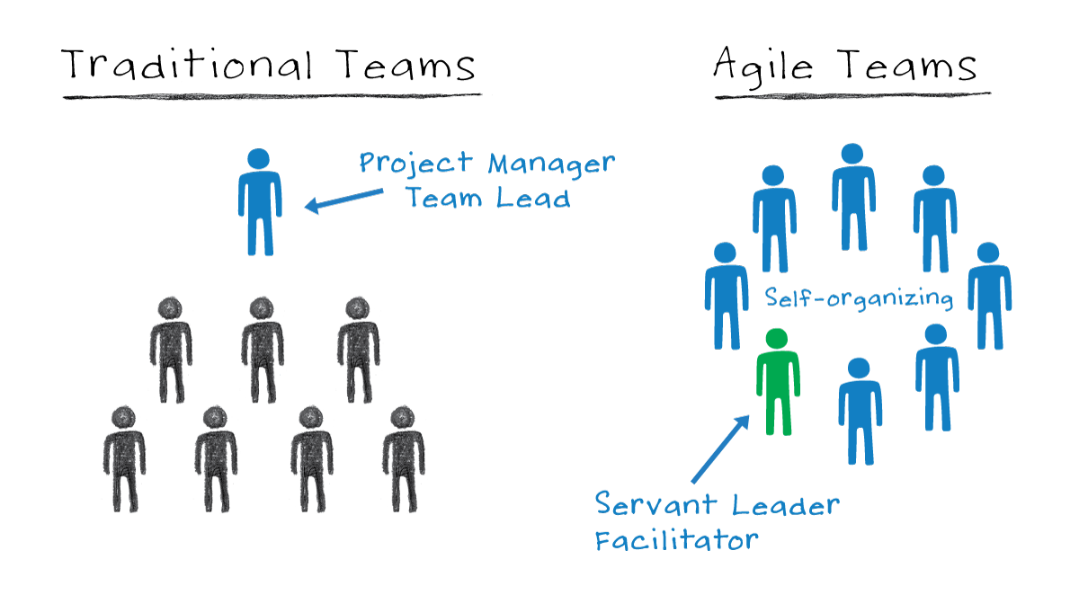
What the heck is a ‘Self-Organizing’ team and why is it important?
Notes:
Self-Organizing teams does not mean that the team gets to choose what the scope is. Does not (always) mean you get to choose who you work with
What it DOES mean:
Team determines the commitment for the iteration
Team determines the work each member will do
Work is NOT assigned to specific members

Slide 24
Why is Agile so much “Better” than my current process?
Notes:
Maybe it isn’t. Each company needs to really think about their current process and future processes. Be thoughtful in making changes.

